Slide 1
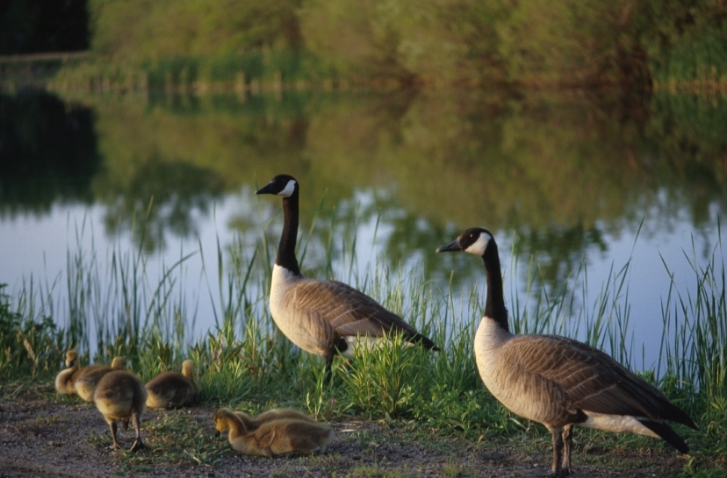
A more complex CR data
wintering site fidelity in Canada Geese Branta canadensis (Hestbeck et al. 1991)
3 sites (large areas along East coast of US):
Carolinas, Chesapeake, Mid-Atlantic
6 years (winter captures+resightings)

Slide 2
A more complex CR data
Conditional Arnason-Schwarz model
Canada goose data
Time
1 2 3 4 5 6
0 0 0 0 0 1 158 History # 1
0 0 0 0 0 2 352 History # 2
0 0 0 0 0 3 271 History # 3
...
0 0 2 0 3 0 7 History # h
...
3 3 3 3 0 3 2 History # 623
3 3 3 3 3 3 3 History # 624

Slide 3
A more complex CR data
Events | States

Slide 4
A more complex CR data
Events | States

Slide 5
A more complex CR data
Events | States
(0) Not encountered
(1) Encountered in NA
(2) Encountered in Ch
(3) Encountered in Ca

Slide 6
A more complex CR data
Events | States
(0) Not encountered | Dead
(1) Encountered in NA | Alive at NA
(2) Encountered in Ch | Alive at Ch
(3) Encountered in Ca | Alive at Ca
Events and states are closely related, but not entirely

Slide 7
Biological inference
Events | States
(0) Not encountered | Dead
(1) Encountered in NA | Alive at NA
(2) Encountered in Ch | Alive at Ch
(3) Encountered in Ca | Alive at Ca

Slide 8
The model construction
How you must think!
States
Dead
Alive at NA
Alive at Ch
Alive at Ca
Events
(0) Not encountered
(1) Encountered in NA
(2) Encountered in Ch
(3) Encountered in Ca
States generate events

Slide 9
The notion of age in CR
The first encounter happens at a different occasion for each individual.
Ex: 0 0 2 0 3 0 first encounter at occasion 3
In CR, ‘age’ = time elapsed since first encounter.
Thus, the ‘age’ of CR models is true age only for individuals marked at birth.
The first encounter corresponds to age 0.
Note: « firste » in Gemaco stands for « first event »

Slide 10
The specificities of the first encounter
The Conditional Arnason-Schwarz model (CAS), like the CJS model, conditions on the first encounter.
i.e. the capture history is modelled from that point only.
Ex: 0 0 2 0 3 0 here from first encounter at occasion 3
The 0’s following the 2 will be interpreted, but not the leading 0’s
NOTE: there are CR models that interpret the leading 0’s (e.g. Jolly 1965; Pradel 1996)

Slide 11
The specificities of the first encounter: events and states
At age 0,
the event ‘not encountered’ is impossible
the state ‘dead’ is impossible

Slide 12
The specificities of the first encounter: events and states
Events | States
(0) Not encountered | Dead
(1) Encountered in NA | Alive at NA
(2) Encountered in Ch | Alive at Ch
(3) Encountered in Ca | Alive at Ca

Slide 13
The state process
1. initial state
It is known exactly: alive at site of initial capture

Slide 14
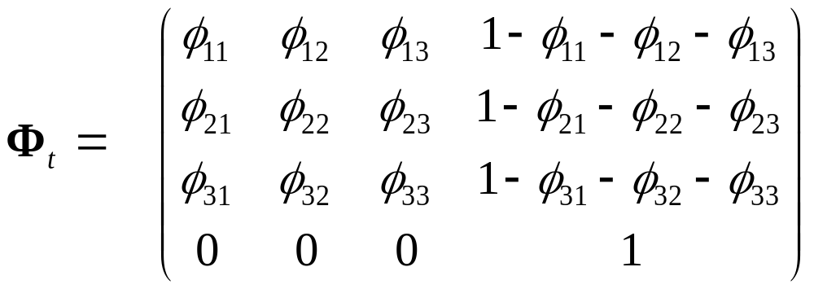
The state process
2. subsequent states
It is described by the transition matrix:
NA Ch Ca †
NA
Ch
Ca
†

Slide 15
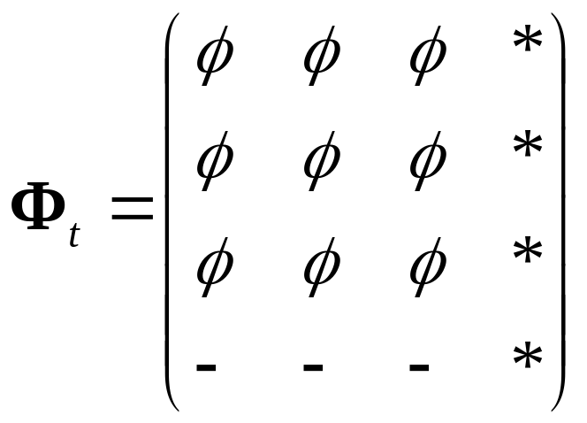
The state process
2. subsequent states
In GEPAT

Slide 16
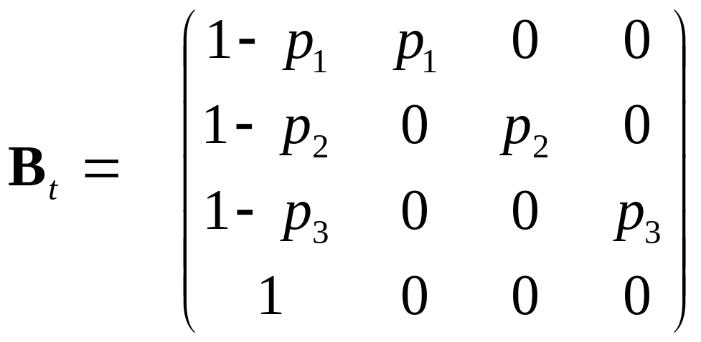
The event process
It is described by the event matrix:
0 1 2 3
NA
Ch
Ca
†

Slide 17
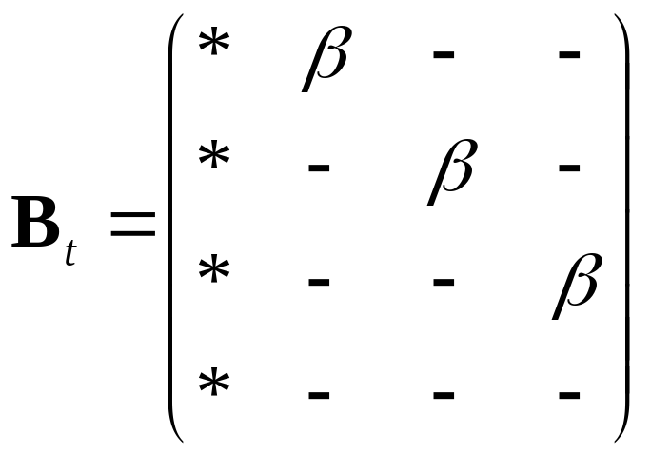
The event process
In GEPAT

Slide 18
Alternative parameterization for the state process
Transition between successive wintering sites can be viewed as involving two distinct processes:
S : survival followed by
Ψ : movement conditional on survival
Notes:
Each phi is the product of survival and movement.
Phi: probability to survive and to move to site 1 given that individual was at time t-1 and t in site 1

Slide 19
Step 1: Survival
IN ROW: Ai : Alive at site i; D dead
IN COLUMN: SFi : Survivor from site i; D dead
        SF1 SF2 SF3 D
A1 s₁  0 01− s₁
A2  0 s₂  01− s₂
A3  0 0 s₃ 1− s₃
0 0 0 1
D

Slide 20
Step 2: Movement
IN ROW: SFi : Survivor from site i; D dead
IN COLUMN: Ai : Alive at site i; D dead
        A1 A2 A3 D
SF1 ψ₁₁  ψ₁₂  ψ₁₃  0
SF2  ψ₂₁  ψ₂₂  ψ₂₃  0
SF3  ψ₃₁  ψ₃₂  ψ₃₃  0
0 0 0 1
D

Slide 21
Some cases of uncertainty in the initial state
Breeding status (Kendall et al., 2003; Pradel 2005)
Sex membership (Fujiwara & Caswell, 2002; Nichols et al., 2004; Pradel et al., 2008)
Hidden heterogeneity (Pledger et al., 2003)
Epidemiology (Conn & Cooch, 2009)
Notes:
Snow geese

Slide 22
Breeding status
3 states:
  breeding (B)
  non-breeding (NB)
  Dead (†)
4 events:
  Not encountered (0)
  Found, ascertained as breeder (1)
  Found, ascertained as non-breeder (2)
  Found, status unknown (3)

Slide 23
The model construction
States
Breeding
Non-breeding
Dead
Events
(0) Not encountered
(1) Found, identified as B
(2) Found, identified as NB
(3) Found, status unknown
Each live state can generate 3 different events

Slide 24
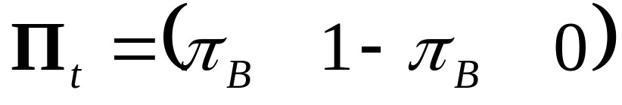
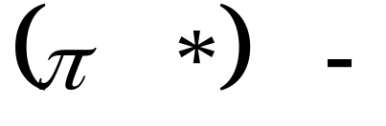
Breeding status:
1.initial state probabilities
π_{B} probability that a newly encountered individual is a breeder
B NB †
In GEPAT

Slide 25
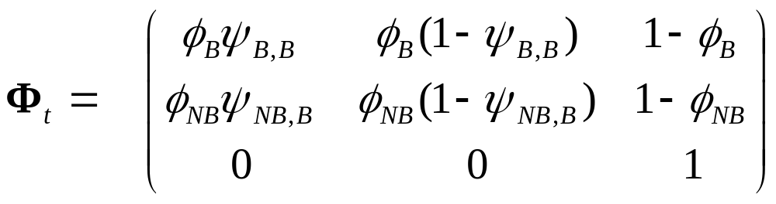
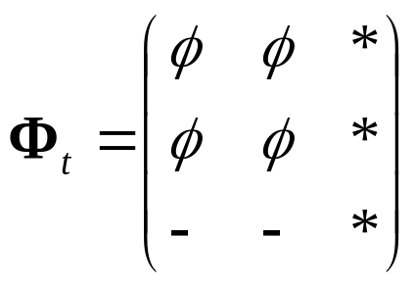
transition parameters
B NB †
B
NB
†
GEPAT

Slide 26
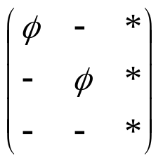
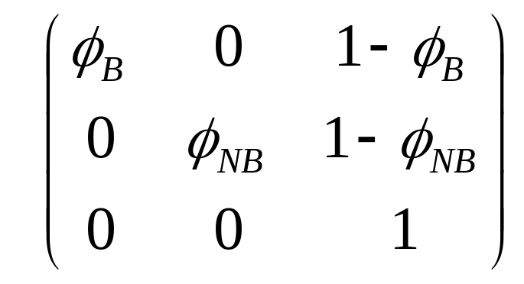
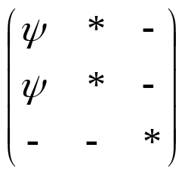
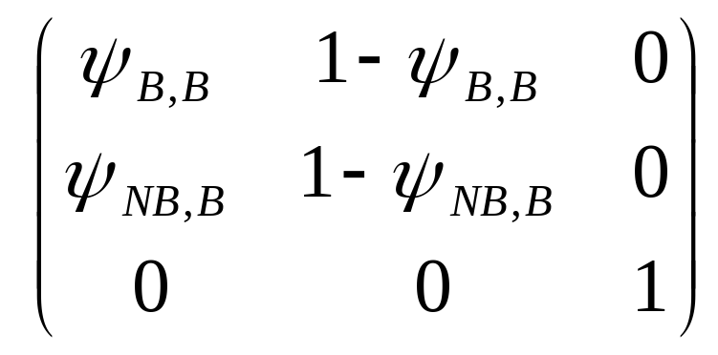
transition parameters
or equivalently (two steps)
SB SNB †
B(t)
NB(t)
†
Step 1: Survival
Intermediate states: SB = ‘surviving breeder’; SNB = ‘surviving non-breeder’
B(t+1) NB(t+1) †
SB
SNB
†
Step 2: Breeding

Slide 27
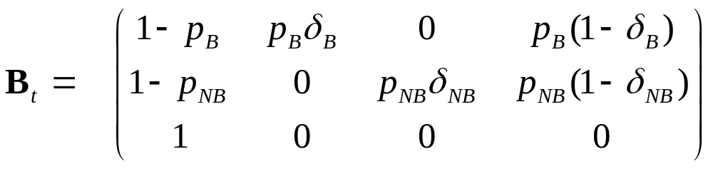
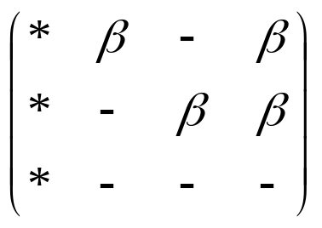
event parameters
0 1 2 3
B
NB
†
B
NB
†
GEPAT

Slide 28
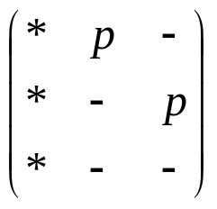
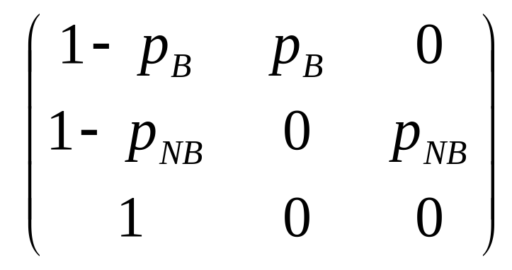
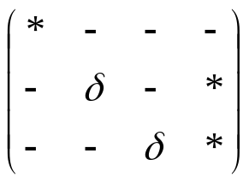
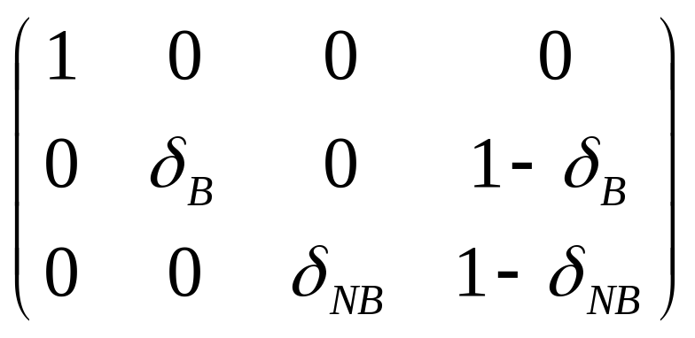
event parameters
or equivalently (two steps)
NE E_{B} E_{NB}
B
NB
†
Step 1: Encounter
Intermediate events: NE = ‘not encountered’; E = ‘encountered’
0 1 2 3
NE
E_{B} E_{NB}
Step 2: Breeding assessment

Slide 29
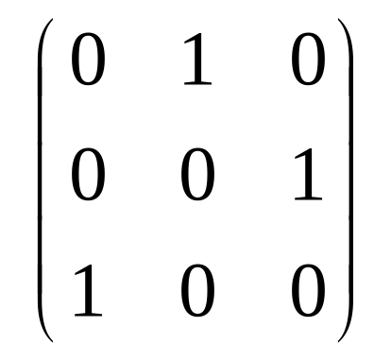
Initial events
Step 1 (encounter) is degenerate because animals are all captured.
=> This will be treated as an age effect: p=1 at age 0
NE E_{B} E_{NB}
NE E_{B} E_{NB}
B
NB
†
B
NB
†
p=1
Step 2 (Breeding assessment) is unaffected
0 1 2 3
NE
E_{B} E_{NB}

Slide 30
The generic multievent model
b, probabilities of events conditional on current state
E₁
E₂
E₃
events
S₁
S₂
S₃
states
π, initial state probabilities
φ probabilities of transition
Note: it belongs to the class of Hidden Markov Models
Notes:
A typical sequence in a capture history would be…. The truth is

Slide 31
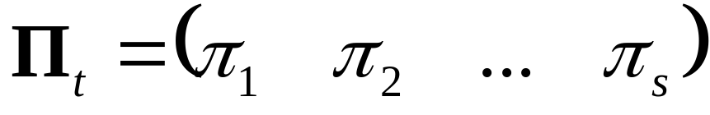
initial state parameters
related to sex-ratio, prevalence of a disease, percentage of breeders…
Reminder: apply to newly captured

Slide 32
Important warning!
The initial state probabilities reflect the relative importance of the different states but only indirectly. They are biased by:
the relative catchability in each state,
the proportion already marked in each state.

Slide 33
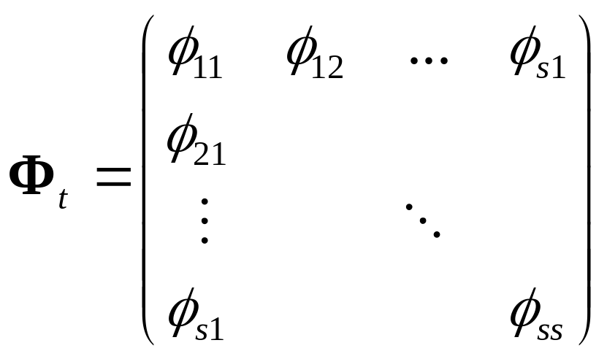
transition parameters
Φ_{t} is row-stochastic

Slide 34

event parameters
generalizes capture probabilities
e.g. prob(seen/breeder)=p_{breeder}
Remark: states in rows, events in columns,
Β_{t} is row-stochastic

Slide 35


